Slide 1

Hotel Rates & Description
Joint Annual Meeting of the SSC, SSCVTS and SSP 2016 Congress
Lausanne, Switzerland – June 15 – 17, 2016

Slide 2
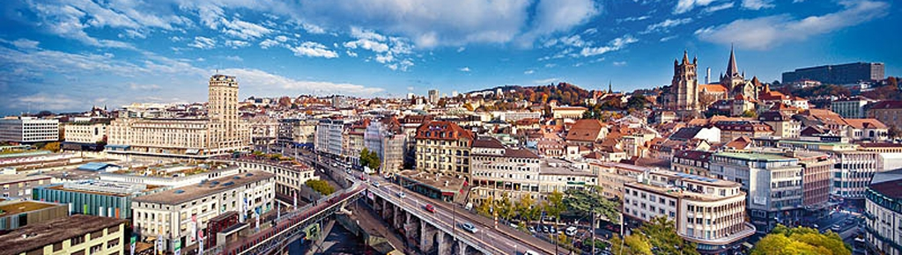
How to use the document?
Hotels List
Click on in the left-upper corner of the page to access the hotel list
Click on the name of the Hotel to access its description
Maps are available at the end of the document
From the maps, click on the numbers to access the hotels’ description
Hotels List

Slide 3
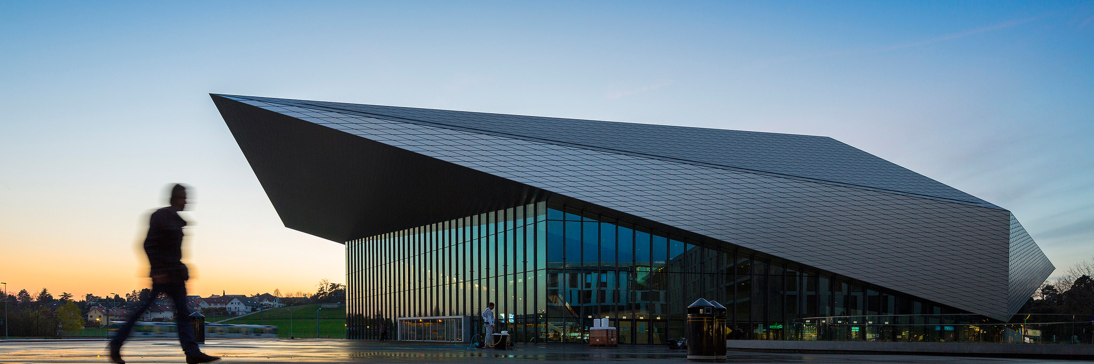
List of hotels by category
Hotels List
4* hotels
Starling Lausanne – Convention center
Continental – City center
2* hotel
Swisstech hotel – Convention center

Slide 4

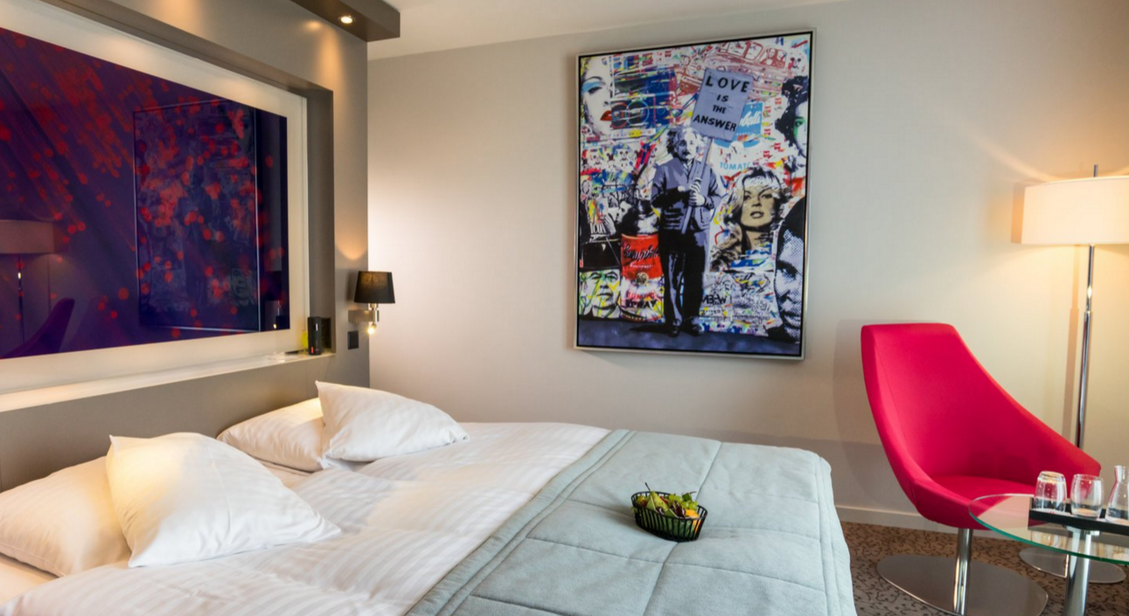
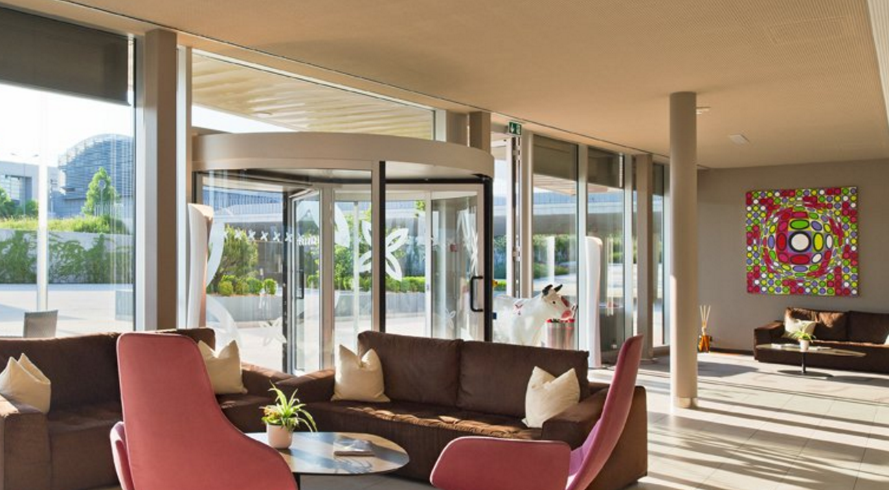

Starling Lausanne - 4 - Convention center
Hotels List
Room Type:
Standard Room - 24sqm with bath and 160x200cm bed
Facilities:
Restaurants & Bars: 0 restaurant and 1 bar
Meeting Rooms : 6 meeting spaces
Transportation:
Closest Bus/Tram stop: Tube M1, EPFL Stop
Room Type | 14-18 June |  | Breakfast | City Tax Rate | N° MAP | Distance to SwissTech Convention Center (walking) | Driving Distance to SwissTech Convention Center
 | SINGLE RATE | DOUBLE RATE
Standard Room | CHF 220 | CHF 240 | Included | CHF 2,80 |  | 17 min (1,4km) | 3 min
1

Slide 5

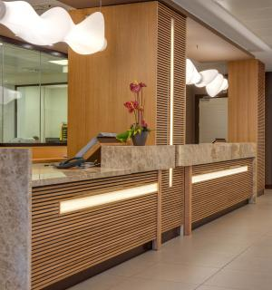
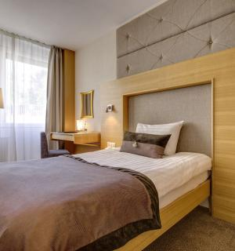
Continental - 4 - City center
Hotels List
Room Type:
Standard Room – 20sqm with shower and 120x140cm bed
Facilities:
Restaurants & Bars: 1 Breakfast restaurant and 1 bar
Meeting Rooms : 7 meeting spaces
Transportation:
Closest Bus/Tram stop: Lausanne train station
Room Type | 14-18 June | Breakfast | City Tax Rate | N° MAP | Distance to SwissTech Convention Center (Public transportation) | Driving Distance to SwissTech Convention Center
 | SINGLE RATE
Standard Room | CHF 210 | CHF 20,00 | CHF 3,50 |  | 22 min | 15 min
2

Slide 6
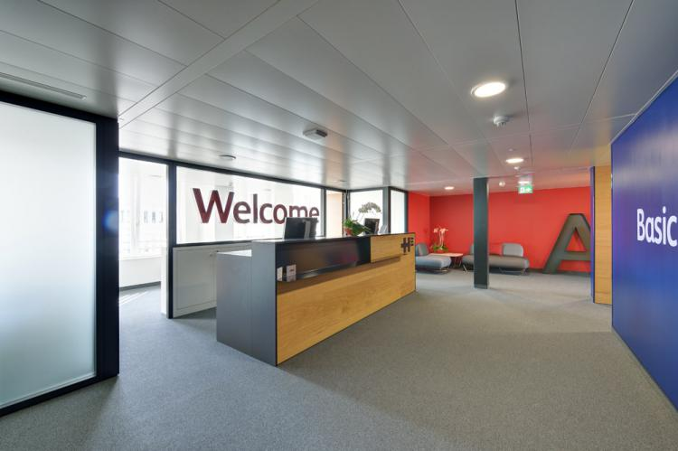
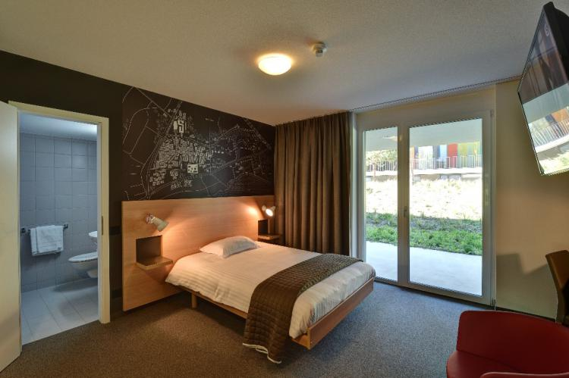
SwissTech Hotel - 2 - Convention center
Hotels List
Room Type:
Standard Room - 18sqm with shower and 160x200cm bed
Facilities:
Restaurants & Bars: 0 restaurant
Meeting Rooms : N/A
Transportation:
Closest Bus/Tram stop: Tube M1, EPFL Stop
Room Type | 14-18 June |  | Breakfast | City Tax Rate | N° MAP | Distance to SwissTech Convention Center (walking) | Driving Distance to SwissTech Convention Center
 | SINGLE RATE | DOUBLE RATE
Standard Room | CHF 125 | CHF 125 | CHF 11,00 | CHF 2,50 |  | 9 min (750m) | 1 min
3

Slide 7
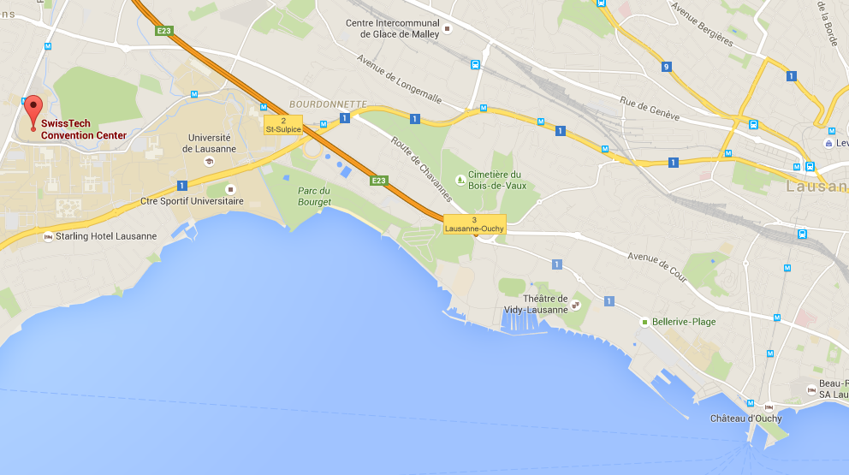
Map Overall
Hotels List
3
2
1
Legend | HOTEL NAME | NUMBER ON MAP
4 STAR Hotels 2 STAR HOTEL | Starling | 1
 | Continental | 2
 | SwissTech | 3

